Slide 1
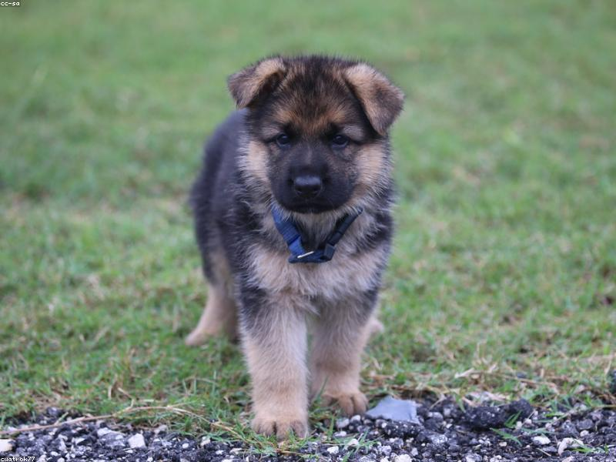
Introduction to Cat Breeds
- Cats are one of the most popular pets worldwide.
- There are over 70 recognized cat breeds.
- Each breed has its unique characteristics and traits.

Slide 2
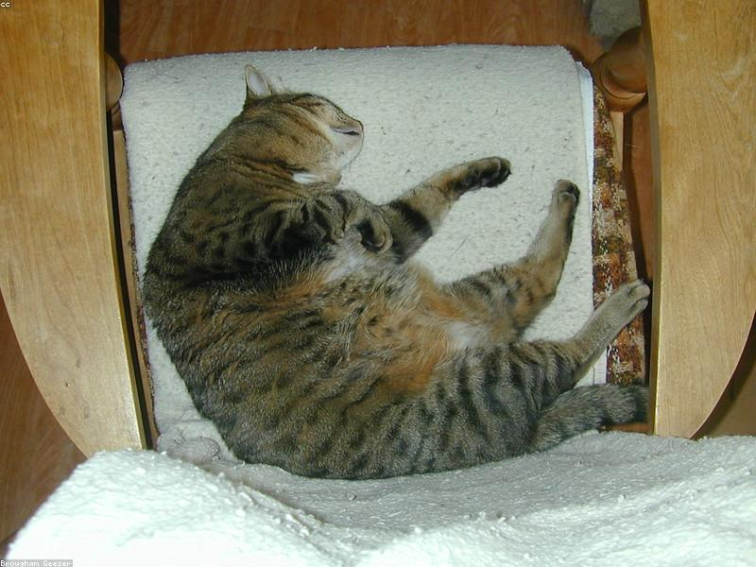
Domestic Shorthair
- The Domestic Shorthair is not a specific breed but a category.
- Known for their playful and friendly nature.
- They come in various colors and patterns.

Slide 3

Siamese Cats
- Siamese cats are known for their striking blue eyes.
- They are very vocal and enjoy interacting with their owners.
- Their coat is short and sleek, with color points on ears, face, paws, and tail.

Slide 4
Persian Cats
- Persian cats have long, luxurious fur and a flat face.
- They are known for their calm and gentle temperament.
- Require regular grooming to maintain their coat.

Slide 5
Maine Coon
- Maine Coons are one of the largest domestic cat breeds.
- They are known for their friendly and sociable nature.
- Have tufted ears and bushy tails, suited for cold climates.

